Slide 1

215EXS2201 Design-Build
Low-Cost Smart Crutch for Safe Injury Rehabilitation and Recovery Monitoring
Research Scholar:
TEAM:10
Nikhilsai (99240040748), 2nd Year, CSE
Kowshik Reddy (99240040758) ,2nd Year, CSE
Shanbu Sundar Reddy (99240040550),2nd Year ,CSE
Thilak (9924005117), 2nd Year, ECE
Supervisor:
Dr.S.Sakthivel,
Associate Professor,
Department of Biomedical Engineering,
KARE.
SCHOOL OF ELECTRONICS, ELECTRICAL AND BIOMEDICAL TECHNOLOGY
DEPARTMENT OF BIOMEDICAL ENGINEERING

Slide 2
INTRODUCTION
Rehabilitation after lower limb injuries requires controlled weight bearing and proper gait assistance.
Traditional crutches provide only physical support, not monitoring.
Patients often face:
This leads to:
Need:
Incorrect weight application
Delayed healing
A smart system that guides and monitors rehabilitation
Improper walking posture
Risk of re-injury
Lack of recovery tracking
Design-Build | Smart Crutch System
02

Slide 3
Abstract:-
This project proposes an intelligent and personalized smart crutch system designed to support rehabilitation through real-time monitoring and feedback.
The system integrates sensors to measure load and detect gait patterns, providing instant vibration-based alerts to users. A mobile application records data, generates progress reports, and enables remote monitoring. Machine learning techniques are incorporated to analyze rehabilitation patterns and predict recovery status.
This system transforms a conventional crutch into a smart healthcare assistant, improving recovery safety, efficiency, and personalization.
Design-Build | Smart Crutch System
03

Slide 4
Objective:-
1
To develop a smart crutch with load and motion sensing
2
To provide real-time feedback using vibration alerts
3
To design a mobile application for monitoring and tracking
4
To analyse rehabilitation using AI/ML techniques
5
To enable doctor and guardian monitoring
6
To improve safe and efficient recovery
7
To reduce the risk of incorrect weight bearing and secondary injuries
8
To improve rehabilitation efficiency and recovery time
Design-Build | Smart Crutch System
04

Slide 5
Literature Review:-
Author(s) | Methodology | Journal Name | Year | Inference
García-Barrios et al. | Cognitive offloading model in human-AI systems | IEEE | 2026 | AI improves decision-making but depends on interaction design
Guo et al. | Shoe-based sensors + ML for gait analysis | IEEE TNSRE | 2025 | Accurate prediction but lacks real-time feedback and assistive support
Varghese et al. | IoT-based smart crutch with sensor monitoring | IJIRSET | 2024 | Enables remote monitoring but lacks AI-based analysis and real-time feedback
Naets et al. | Smart walker with multi-sensor monitoring | IEEE Access | 2022 | Effective in clinics but lacks portability and AI-based personalization
Design-Build | Smart Crutch System
05

Slide 6
Literature Review
continued
Author(s) | Methodology | Journal | Year | Inference
Mukherjee et al | Beta regression model for gait analysis | IEEE JBHI | 2025 | Accurate gait analysis but lacks real-time assistive feedback
Arcobelli et al | mHealth-based smart crutch with remote monitoring | Sensors | 2023 | Supports remote care but lacks AI analysis and real-time feedback
Sarkar et al | IoT-based smart crutch with e-care architecture | IEEE TENSYMP | 2020 | Enables remote monitoring but lacks AI analysis and real-time feedback
Yang et al | Multifunctional smart crutch for elderly monitoring | IEEE DASC | 2019 | Improves safety but lacks AI analysis and real-time feedback
Design-Build | Smart Crutch System
06

Slide 7
Literature Review
continued
Author(s) | Methodology | Journal | Year | Inference
Viegas et al | Load cells + optical sensors for walker monitoring | Sensors | 2018 | Accurate monitoring but lacks real-time feedback and AI integration
Chen et al | Instrumented smart crutches for rehab & exoskeleton support | IEEE BIOROB | 2018 | Improves assistive support but lacks AI analysis and real-time feedback
Kyritsis et al | Smart device-based gait recognition system | IEEE AI4I | 2018 | Enables gait analysis but lacks real-time feedback and assistive integration
Sugiyama et al | Crutch training system with fall simulation | IEEE SMC | 2018 | Improves training but lacks real-time monitoring and AI-based analysis
Design-Build | Smart Crutch System
07

Slide 8
Existing Method Disadvantages :-
1
No real-time monitoring
2
No feedback system
3
No gait analysis
4
No recovery tracking
5
No AI-based insights
6
No remote doctor monitoring
Patients depend only on guesswork
Design-Build | Smart Crutch System
08

Slide 9
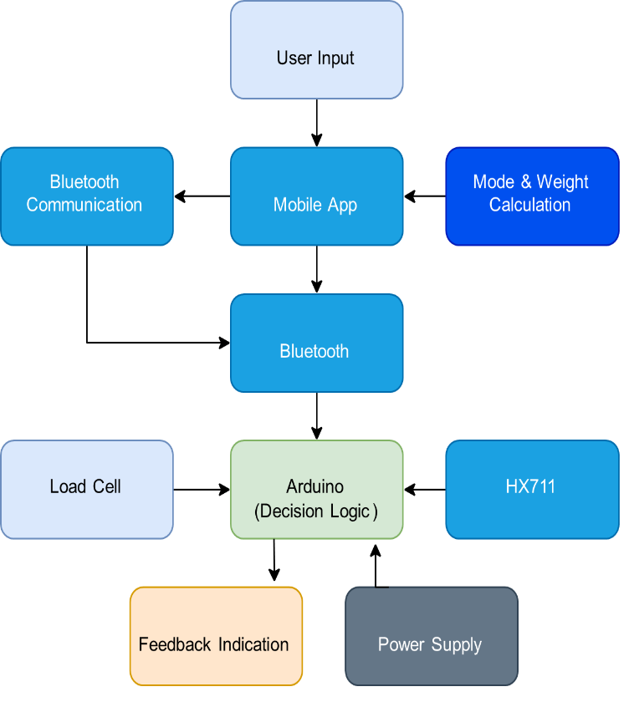
Proposed Method (Block Diagram):-
Design-Build | Smart Crutch System
09

Slide 10
Methodology:-
Sensor data collection (Load + Motion)
Data processing using ESP32
Real-time transmission via Bluetooth
Data storage in mobile app
1
2
3
4
ML-based analysis
Feedback generation
Cloud synchronization
5
6
7
Design-Build | Smart Crutch System
10

Slide 11
Explanation of Methodology:-
1
Load sensor measures applied weight
2
MPU6050 detects motion and gait
3
ESP32 processes sensor data
4
Bluetooth sends data to mobile app
5
App analyzes and stores data
6
ML predicts recovery status
7
Vibration alerts notify incorrect usage
8
Cloud enables remote monitoring
Design-Build | Smart Crutch System
11

Slide 12
Future Work:-
Advanced AI prediction models
Real-time doctor dashboard
1
2
Voice assistance for patients
Clinical testing and validation
3
4
App development with cloud storage
Startup-level product development
5
6
Design-Build | Smart Crutch System
12

Slide 13
REFERENCE
[1] D. A. García-Barrios, “Epistemic partner or cognitive crutch: A conceptual model of cognitive offloading in human–artificial intelligence collaboration,” IEEE, pp. 7–8, Jan. 2026, doi: 10.1109/MIC.2025.3626694.
[2] R. Varghese, Ananya R., N. V., Sagarika T. H., and Sanjana N., “Smart crutches using IOT,” Int. J. Innov. Res. Sci. Eng. Technol. (IJIRSET), vol. 13, no. 8, pp. 15549-15551, Aug. 2024.
[5] M. Mukherjee, A. I. Faisal, N. Balakrishnan, S. Kumar, and M. J. Deen, “An inferential model for understanding the effects of demographic and gait factors and their interactions on the human gait index: A beta regression approach,” IEEE Journal of Biomedical and Health Informatics, vol. 29, no. 10, Oct. 2025.
[6] V. A. Arcobelli, M. Zauli, G. Galteri, L. Cristofolini, L. Chiari, A. Cappello and L. De Marchi,“mCrutch: A Novel m-Health Approach Supporting Continuity of Care,” Sensors, vol. 23, no. 8, 2023, doi: 10.3390/s23084151.
[7] P. P. Sarkar, M. A. Tohin, M. A. Khaled, and M. S. Rahman, “Implementation of an instrumented crutch with scalable E-care architecture using IoT,” in Proc. 2020 IEEE Region 10 Symposium (TENSYMP), 2020, pp. 242-245.
[8] R. Sugiyama, N. Tsuda, N. Kato, and Y. Nomura, “Modelling of crutch walk training system with falling sensation device,” in Proc. 2018 IEEE Int. Conf. Systems, Man, and Cybernetics (SMC), 2018.
[3] Z. Guo, Y. Li, Y. Wang, H. Liu, R. Guo, J. Ma, X. Wu, D. Jiang, T.Ren, “Intelligent diagnosis and predictive rehabilitation assessment of chronic ankle instability using shoe-integrated sensor system,” IEEE Trans. Neural Syst. Rehabil. Eng., vol. 33, 2025.
[4] B. Naets, Z. Guo, Y. Li, Y. Wang, H. Liu, J. Ma, X. Wu, T. Ren, D. Jiang, and R. Guo, “Smart walker design for clinical rehabilitation,” IEEE,2022, doi:10.1109/ACCESS.2022.2973815.
Design-Build | Smart Crutch System
15

